Slide 1
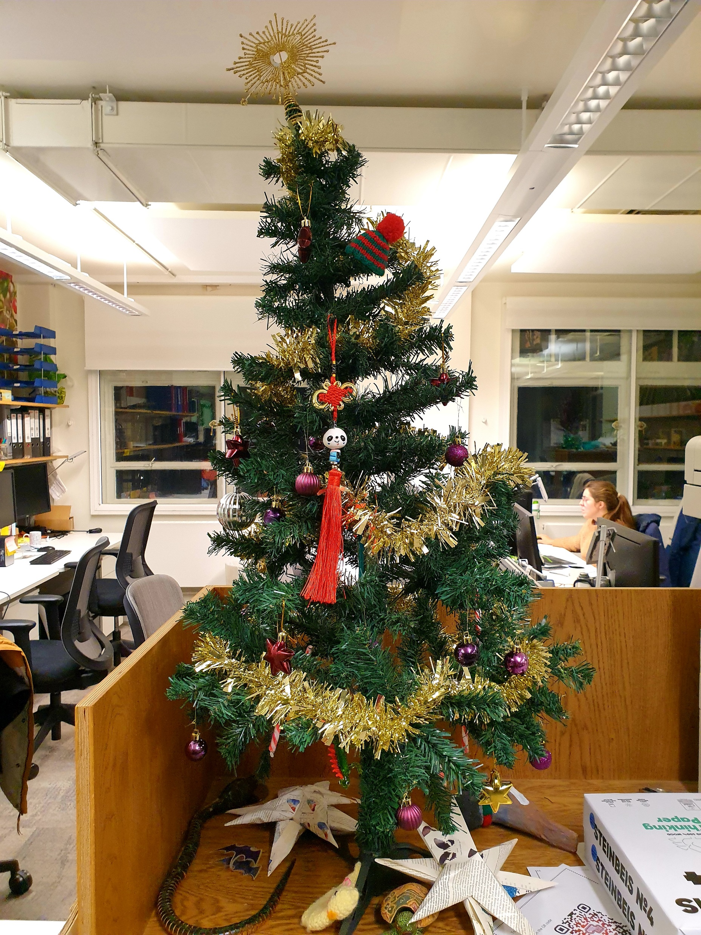
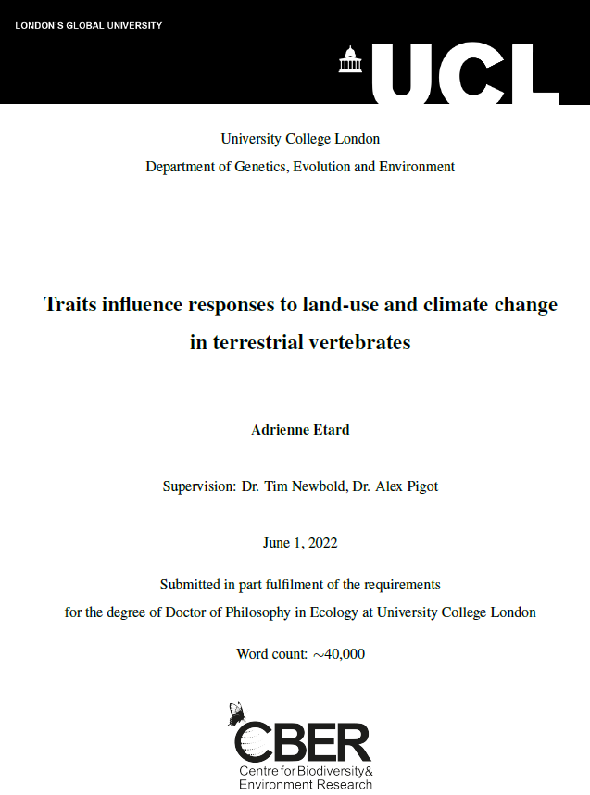
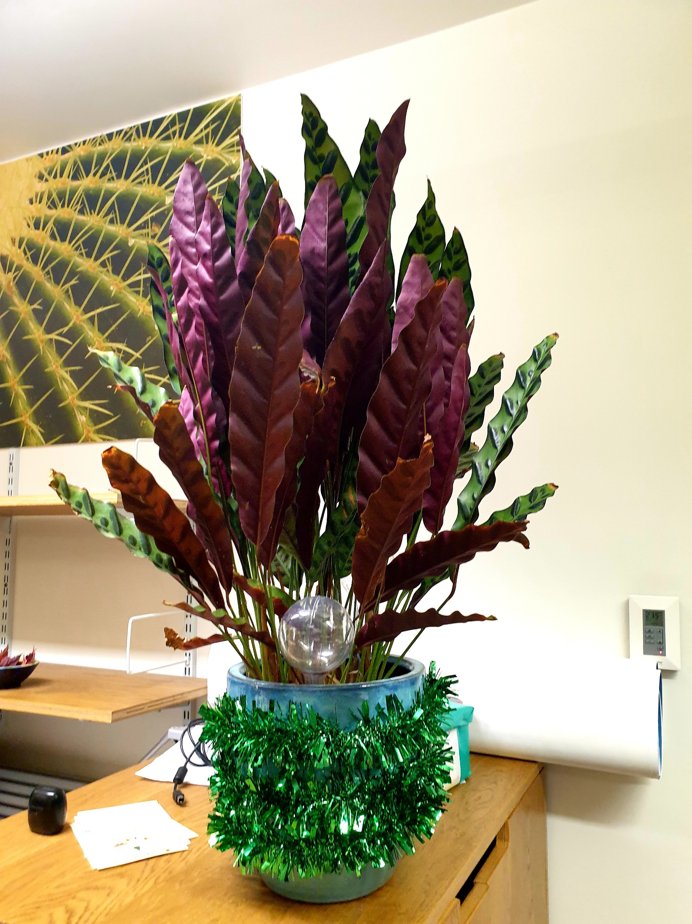
CBER Viva celebration symposium 15/12/2022 Adrienne Etard

Slide 2

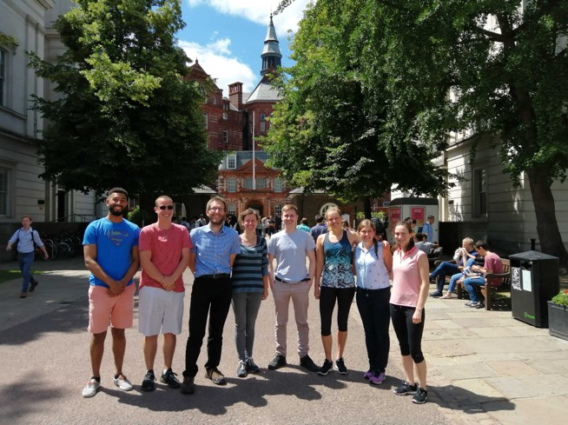
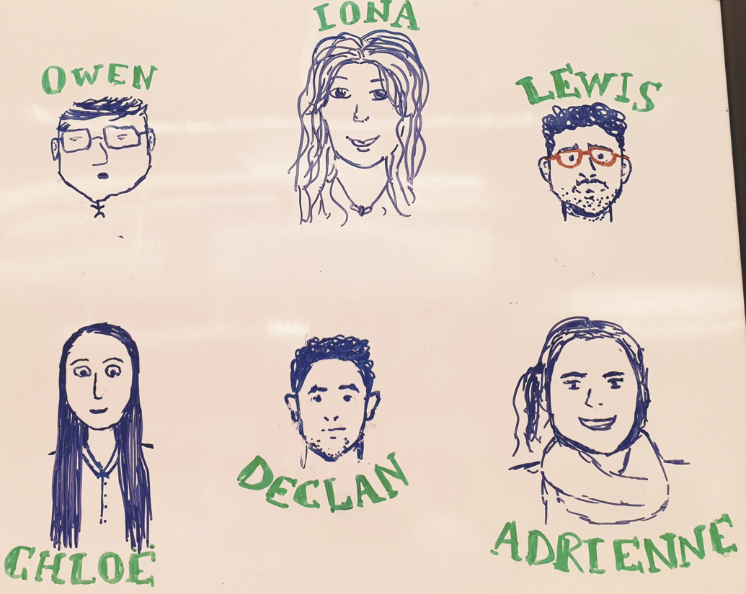

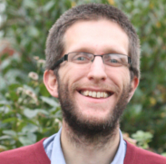
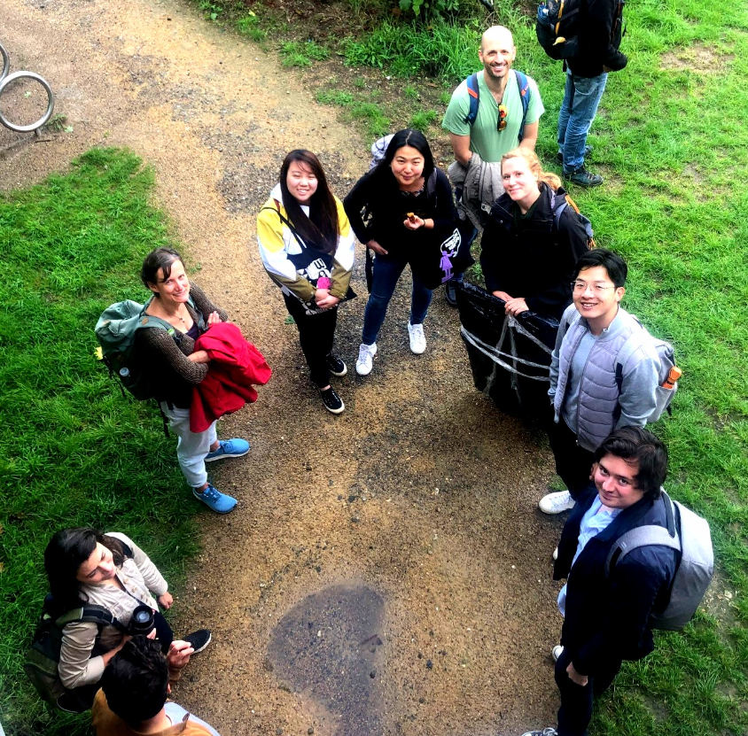

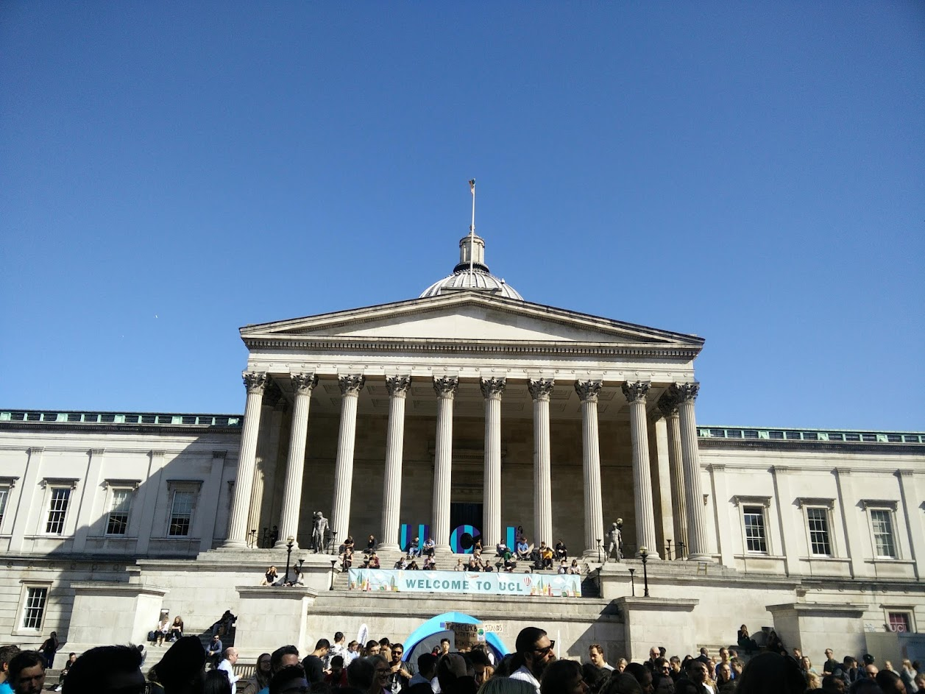
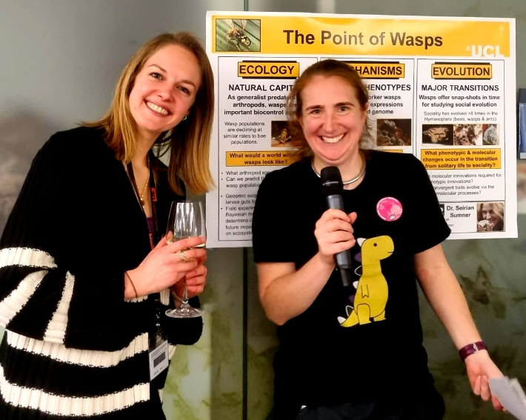

Tim Newbold
Alex Pigot
Richard Pearson

Slide 3
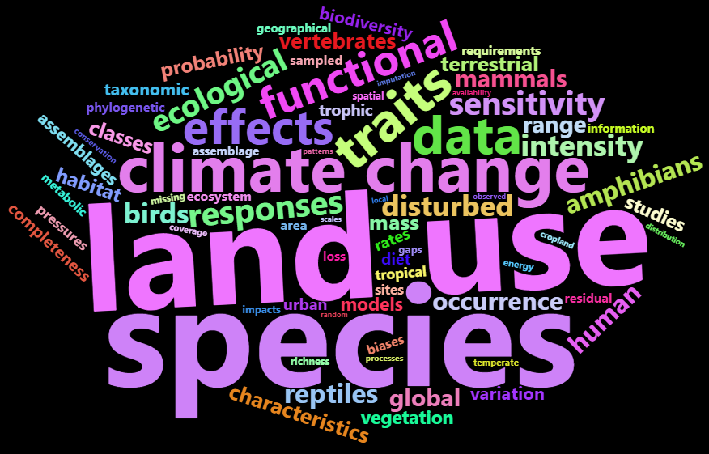
PhD overarching aims
Is interspecific variation in traits associated with species’ responses to land-use & with climate-change sensitivity in terrestrial vertebrates?
What are the possible consequences for ecosystem functioning?
Chapters – in write-up order
Chapter 2: trait data collection
Chapter 3: land-use & functional reshaping (ecological traits)
Chapter 5: land-use & functional reshaping (physiological traits)
Chapter 4: associations between traits, land-use responses and climate-change sensitivity

Slide 4
PhD overarching aims
Is interspecific variation in traits associated with species’ responses to land-use & with climate-change sensitivity in terrestrial vertebrates?
What are the possible consequences for ecosystem functioning?
Chapters – in write-up order
PUBLISHED
Chapter 2: trait data collection
Chapter 3: land-use & functional reshaping (ecological traits)
Chapter 5: land-use & functional reshaping (physiological traits)
Chapter 4: associations between traits, land-use responses and climate-change sensitivity
UNPUBLISHED

Slide 5


Slide 6

June 2018
F
Covid 19 - National
lockdown (late March 2020)
May 2022

Slide 7



May 2019 –
Upgrade
June 2018
F
Covid 19 - National
lockdown (late March 2020)
May 2022
May 2022
Viva
thesis submission!

Slide 8
Nov 2019 –
Paper submitted (Chapter 2)…
and 1st reject resubmit!
May 2019 –
Upgrade
June 2018
F
Covid 19 - National
lockdown (late March 2020)
May 2022
May 2022
Viva
thesis submission!
Oct 2020 –
Paper
published
(Chapter 2)

Slide 9
Nov 2019 –
Paper submitted (Chapter 2)…
and 1st reject resubmit!
May 2019 –
Upgrade
June 2018
F
Covid 19 - National
lockdown (late March 2020)
May 2022
May 2022
Viva
thesis submission!
Nov 2021 –
Paper published
(Chapter 3)
Oct 2020 –
Paper
published
(Chapter 2)
March 2021 –
Paper submitted
(Chapter 3)
Rejected after
peer-review

Slide 10
Nov 2019 –
Paper submitted (Chapter 2)…
and 1st reject resubmit!
May 2019 –
Upgrade
June 2018
F
Covid 19 - National
lockdown (late March 2020)
May 2022
May 2022
Viva
thesis submission!
Nov 2021 –
Paper published
(Chapter 3)
Oct 2020 –
Paper
published
(Chapter 2)
March 2021 –
Paper submitted
(Chapter 3)
Rejected after
peer-review
May 2021 –
Letter of intention
(Chapter 5)
Jan 2021 –
Paper rejected after peer-review
(Chapter 5)
Paper submitted
(Chapter 5)

Slide 11
Nov 2019 –
Paper submitted (Chapter 2)…
and 1st reject resubmit!
May 2019 –
Upgrade
June 2018
F
Covid 19 - National
lockdown (late March 2020)
May 2022
May 2022
Viva
Write-up &
thesis submission!
Nov 2021 –
Paper published
(Chapter 3)
Oct 2020 –
Paper
published
(Chapter 2)
March 2021 –
Paper submitted
(Chapter 3)
Rejected after
peer-review
May 2021 –
Letter of intention
(Chapter 5)
Jan 2021 –
Paper rejected after peer-review
(Chapter 5)
Paper submitted
(Chapter 5)

Slide 12
Nov 2019 –
Paper submitted (Chapter 2)…
and 1st reject resubmit!
May 2019 –
Upgrade
June 2018
F
Covid 19 - National
lockdown (late March 2020)
Sept 2021
Back to CBER!
May 2022
May 2022
Working from home
Viva
Write-up &
thesis submission!
Nov 2021 –
Paper published
(Chapter 3)
Oct 2020 –
Paper
published
(Chapter 2)
March 2021 –
Paper submitted
(Chapter 3)
Rejected after
peer-review
May 2021 –
Letter of intention
(Chapter 5)
Jan 2021 –
Paper rejected after peer-review
(Chapter 5)
Paper submitted
(Chapter 5)

Slide 13
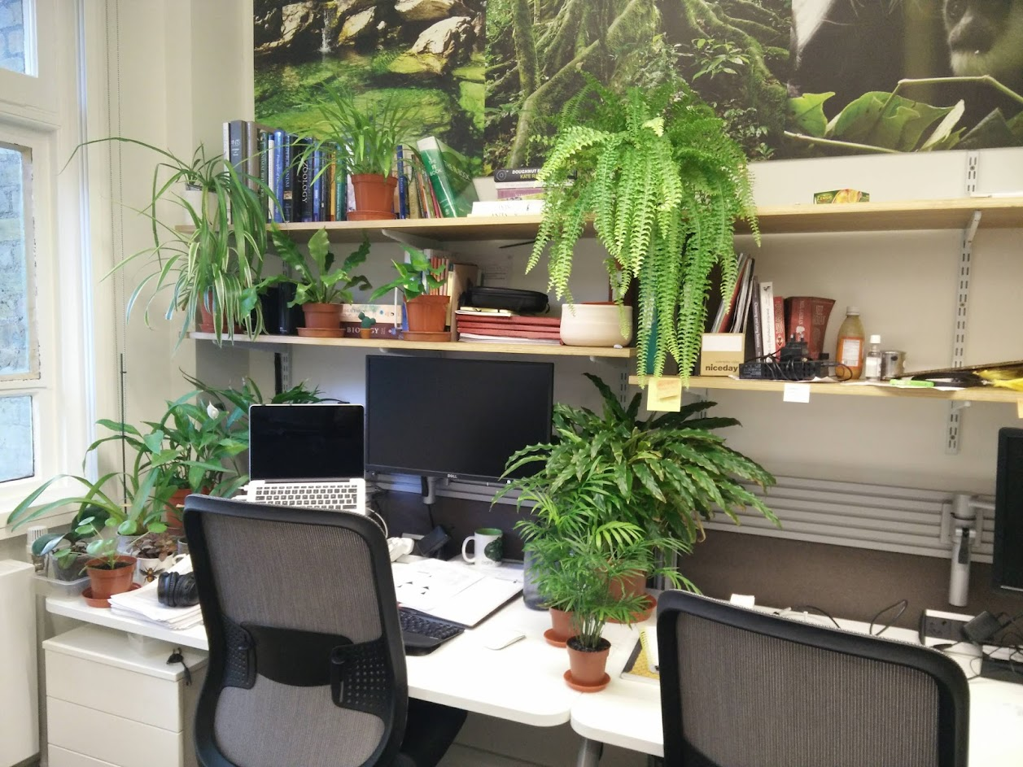
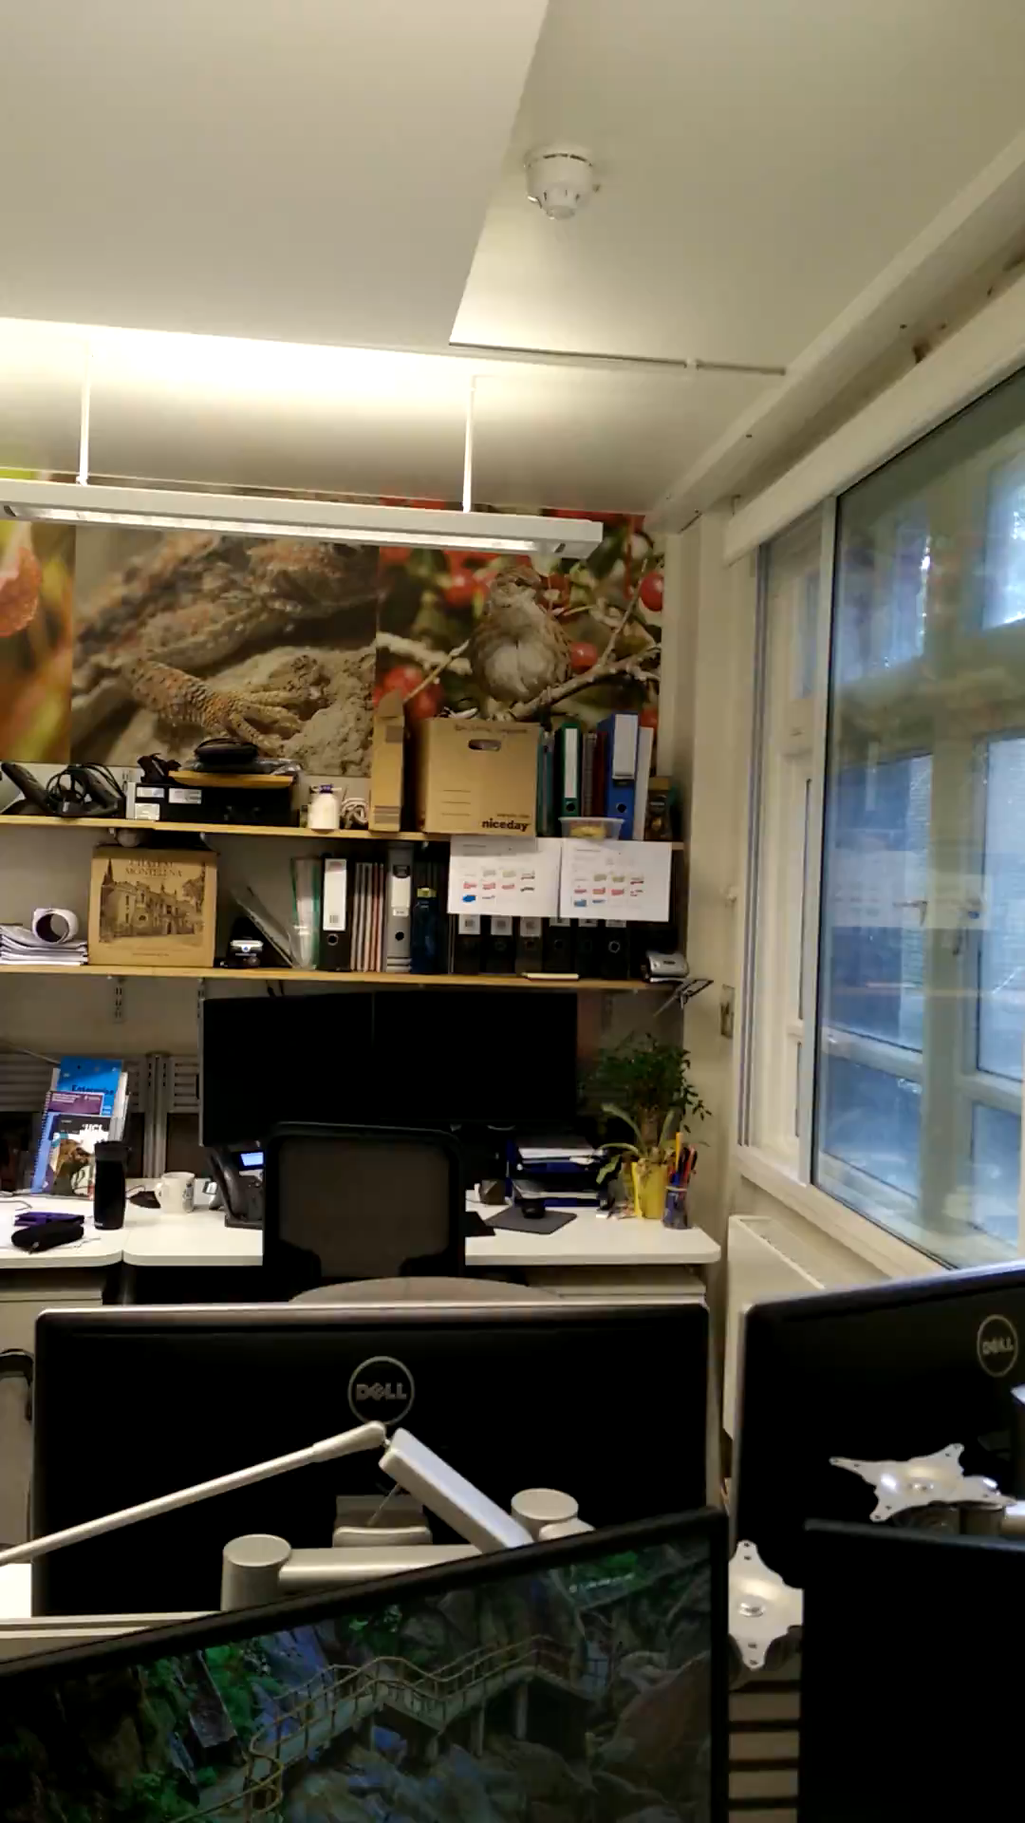
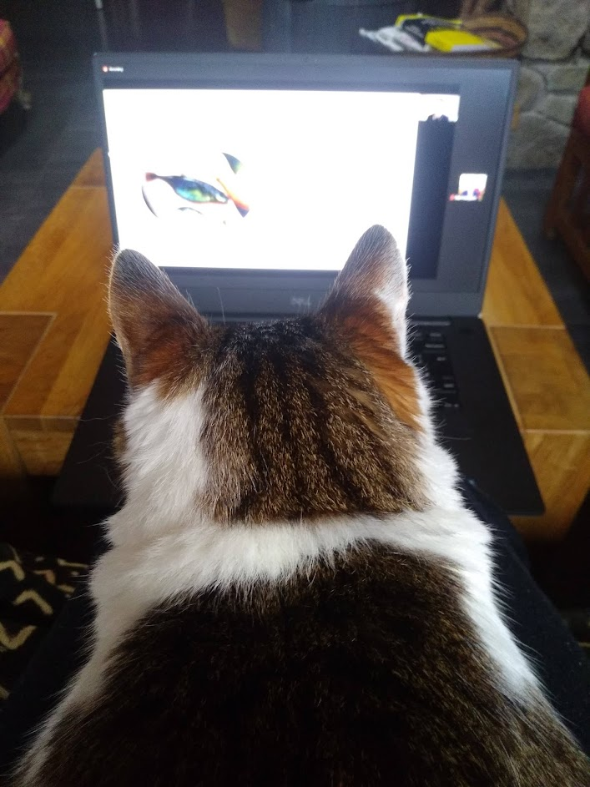
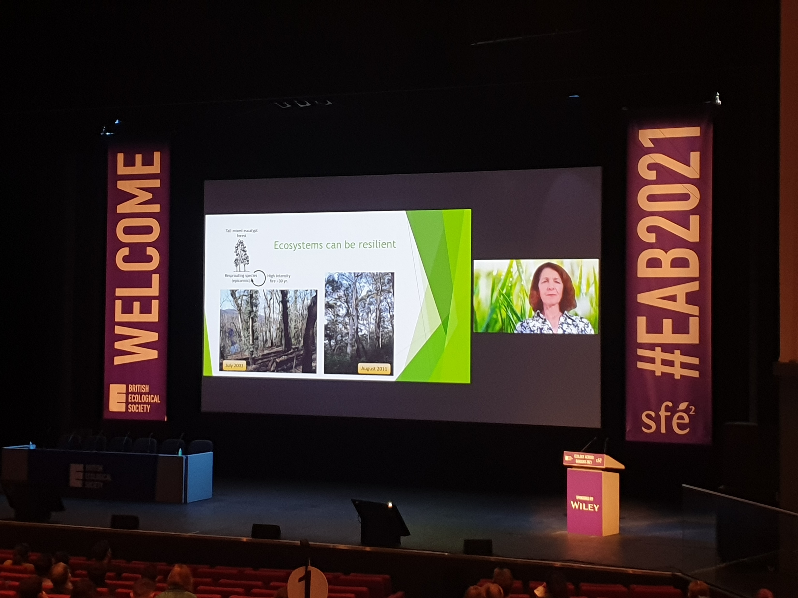
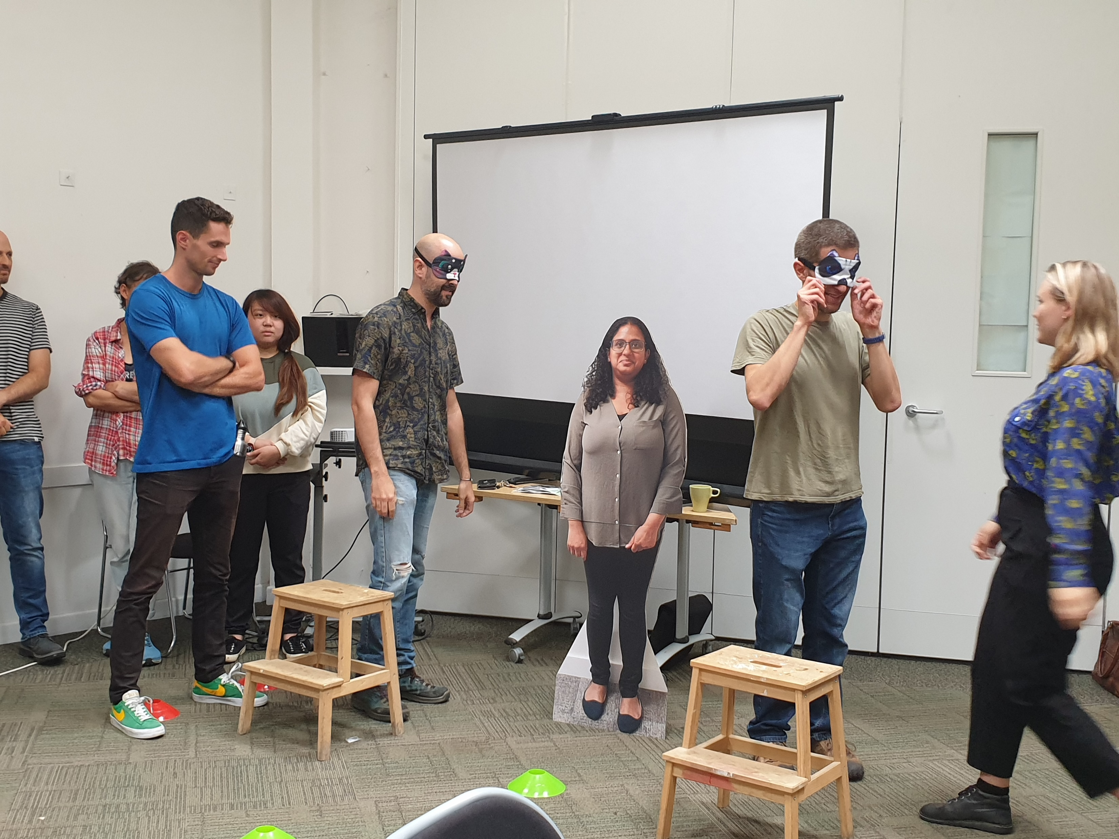
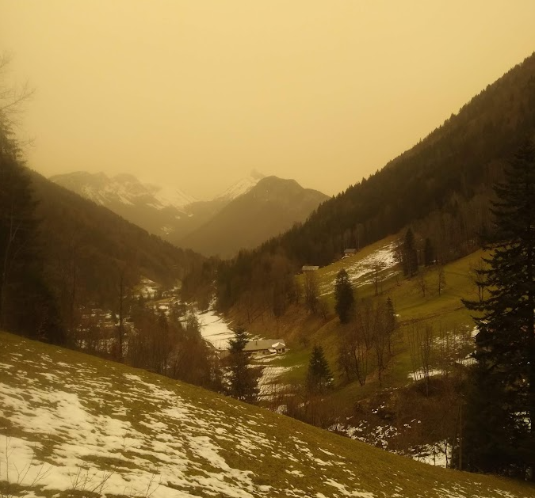
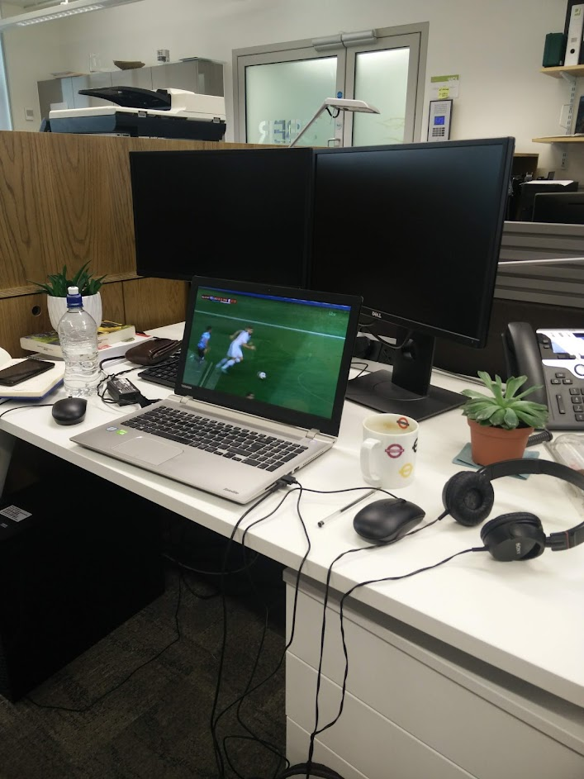
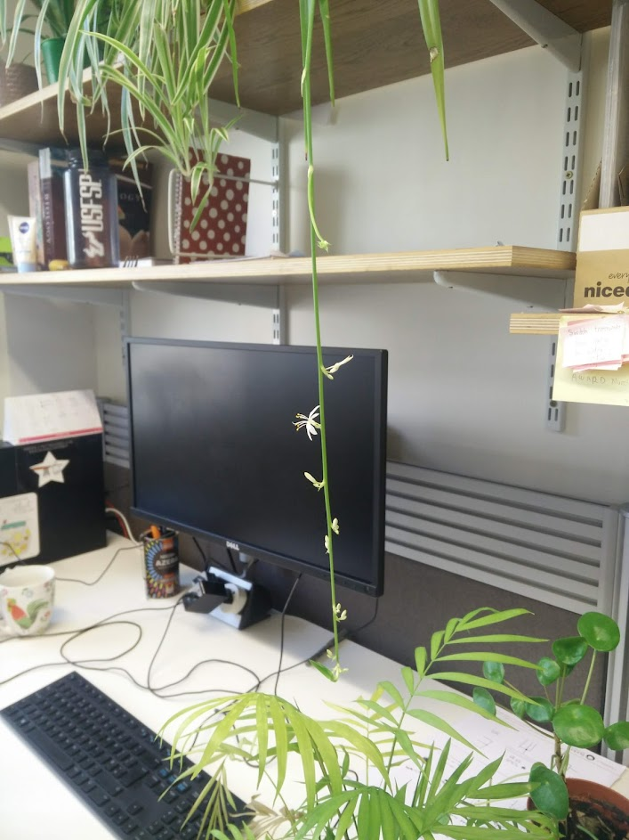

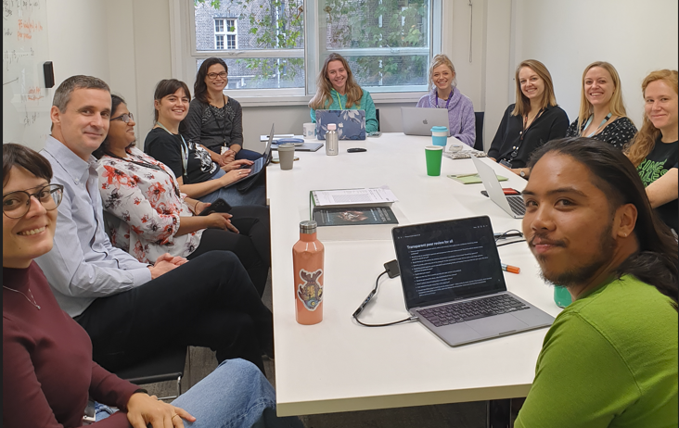
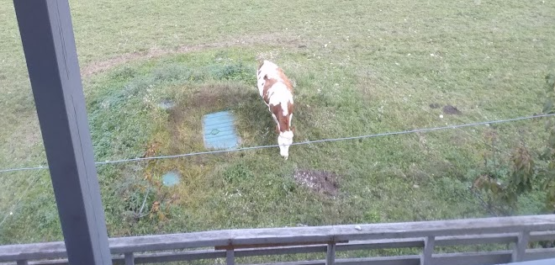
2018
2019
2020 continued…
2021-2022 Return to in-person fun!
March
2020
Plant rescue op

Slide 14
Nov 2019 –
Paper submitted (Chapter 2)…
and 1st reject resubmit!
May 2019 –
Upgrade
June 2018
F
Covid 19 - National
lockdown (late March 2020)
Sept 2021
Back to CBER!
May 2022
May 2022
Working from home
Viva
Write-up &
thesis submission!
Nov 2021 –
Paper published
(Chapter 3)
Oct 2020 –
Paper
published
(Chapter 2)
March 2021 –
Paper submitted
(Chapter 3)
Rejected after
peer-review
May 2021 –
Letter of intention
(Chapter 5)
Jan 2021 –
Paper rejected after peer-review
(Chapter 5)
Paper submitted
(Chapter 5)

Slide 15
Nov 2019 –
Paper submitted (Chapter 2)…
and 1st reject resubmit!
Conferences
May 2019 –
Upgrade
June 2018
F
Covid 19 - National
lockdown (late March 2020)
Sept 2021
Back to CBER!
May 2022
May 2022
Working from home
Viva
Write-up &
thesis submission!
Nov 2021 –
Paper published
(Chapter 3)
Oct 2020 –
Paper
published
(Chapter 2)
March 2021 –
Paper submitted
(Chapter 3)
Rejected after
peer-review
May 2021 –
Letter of intention
(Chapter 5)
Jan 2021 –
Paper rejected after peer-review
(Chapter 5)
Paper submitted
(Chapter 5)

Slide 16
Nov 2019 –
Paper submitted (Chapter 2)…
and 1st reject resubmit!
Conferences
May 2019 –
Upgrade
Talks
June 2018
F
Covid 19 - National
lockdown (late March 2020)
Sept 2021
Back to CBER!
May 2022
May 2022
Working from home
Viva
Write-up &
thesis submission!
Nov 2021 –
Paper published
(Chapter 3)
Oct 2020 –
Paper
published
(Chapter 2)
March 2021 –
Paper submitted
(Chapter 3)
Rejected after
peer-review
May 2021 –
Letter of intention
(Chapter 5)
Jan 2021 –
Paper rejected after peer-review
(Chapter 5)
Paper submitted
(Chapter 5)

Slide 17
Nov 2019 –
Paper submitted (Chapter 2)…
and 1st reject resubmit!
Conferences
May 2019 –
Upgrade
Talks
PGTA duties
June 2018
F
Covid 19 - National
lockdown (late March 2020)
Sept 2021
Back to CBER!
May 2022
May 2022
Working from home
Viva
Write-up &
thesis submission!
Nov 2021 –
Paper published
(Chapter 3)
Oct 2020 –
Paper
published
(Chapter 2)
March 2021 –
Paper submitted
(Chapter 3)
Rejected after
peer-review
May 2021 –
Letter of intention
(Chapter 5)
Jan 2021 –
Paper rejected after peer-review
(Chapter 5)
Paper submitted
(Chapter 5)

Slide 18

Nov 2019 –
Paper submitted (Chapter 2)…
and 1st reject resubmit!
Conferences
May 2019 –
Upgrade
Talks
PGTA duties
June 2018
Peer-reviews
F
Covid 19 - National
lockdown (late March 2020)
Sept 2021
Back to CBER!
May 2022
May 2022
Working from home
Viva
Write-up &
thesis submission!
Nov 2021 –
Paper published
(Chapter 3)
Oct 2020 –
Paper
published
(Chapter 2)
March 2021 –
Paper submitted
(Chapter 3)
Rejected after
peer-review
May 2021 –
Letter of intention
(Chapter 5)
Jan 2021 –
Paper rejected after peer-review
(Chapter 5)
Paper submitted
(Chapter 5)

Slide 19

Nov 2019 –
Paper submitted (Chapter 2)…
and 1st reject resubmit!
Conferences
May 2019 –
Upgrade
Talks
PGTA duties
June 2018
Peer-reviews
F
Collaborations
Covid 19 - National
lockdown (late March 2020)
Sept 2020 –
LPI report
contributions
Jan 2021 –
The Conservation article
contributions
Sept 2021
Back to CBER!
May 2022
Working from home
Viva
Write-up &
thesis submission!
Nov 2021 –
Paper published
(Chapter 3)
Oct 2020 –
Paper
published
(Chapter 2)
March 2021 –
Paper submitted
(Chapter 3)
Rejected after
peer-review
May 2021 –
Letter of intention
(Chapter 5)
Jan 2021 –
Paper rejected after peer-review
(Chapter 5)
Paper submitted
(Chapter 5)

Slide 20
Nov 2019 –
Paper submitted (Chapter 2)…
and 1st reject resubmit!
Conferences
May 2019 –
Upgrade
Talks
PGTA duties
June 2018
Peer-reviews
F
I started working…
Collaborations
Covid 19 - National
lockdown (late March 2020)
Sept 2020 –
LPI report
contributions
Jan 2021 –
The Conservation article
contributions
Sept 2021
Back to CBER!
May 2022
Working from home
Viva
Write-up &
thesis submission!
Nov 2021 –
Paper published
(Chapter 3)
Oct 2020 –
Paper
published
(Chapter 2)
March 2021 –
Paper submitted
(Chapter 3)
Rejected after
peer-review
May 2021 –
Letter of intention
(Chapter 5)
Jan 2021 –
Paper rejected after peer-review
(Chapter 5)
Paper submitted
(Chapter 5)

Slide 21
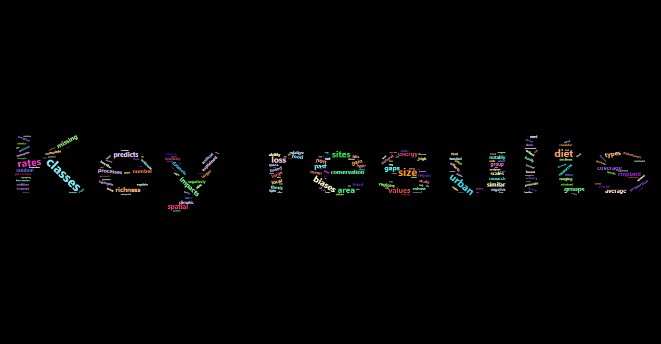

Slide 22

Trait data collection, terrestrial vertebrates
Nov 2019 –
Paper submitted (Chapter 2)…
and 1st reject resubmit!
Conferences
Talks
PGTA duties
June 2018
Peer-reviews
F
I started working…
Collaborations
May 2022
Working from home
Oct 2020 –
Paper
published
(Chapter 2)

Slide 23

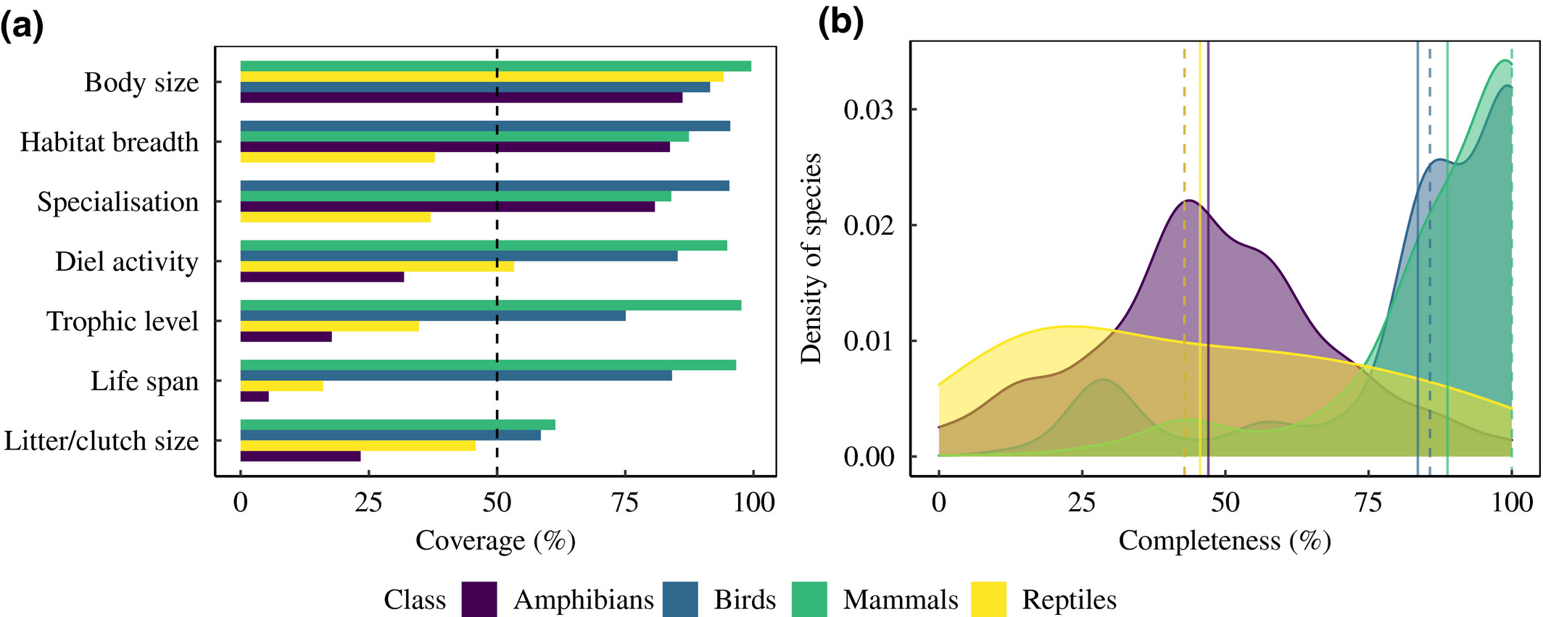
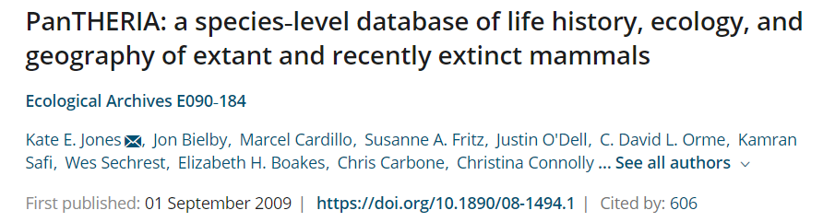
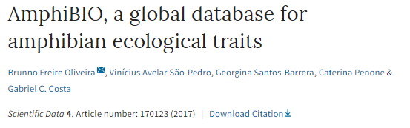

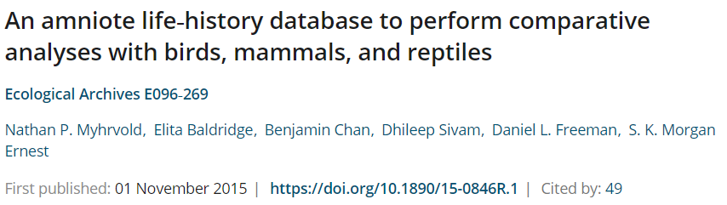
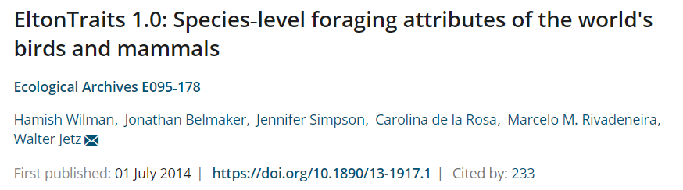
Chapter 2 – Global gaps in trait data for terrestrial vertebrates
Collect trait information across terrestrial vertebrates
Assess gaps and biases in the trait data
From: Etard et al. Global Ecology and Biogeography (2020)

Slide 24
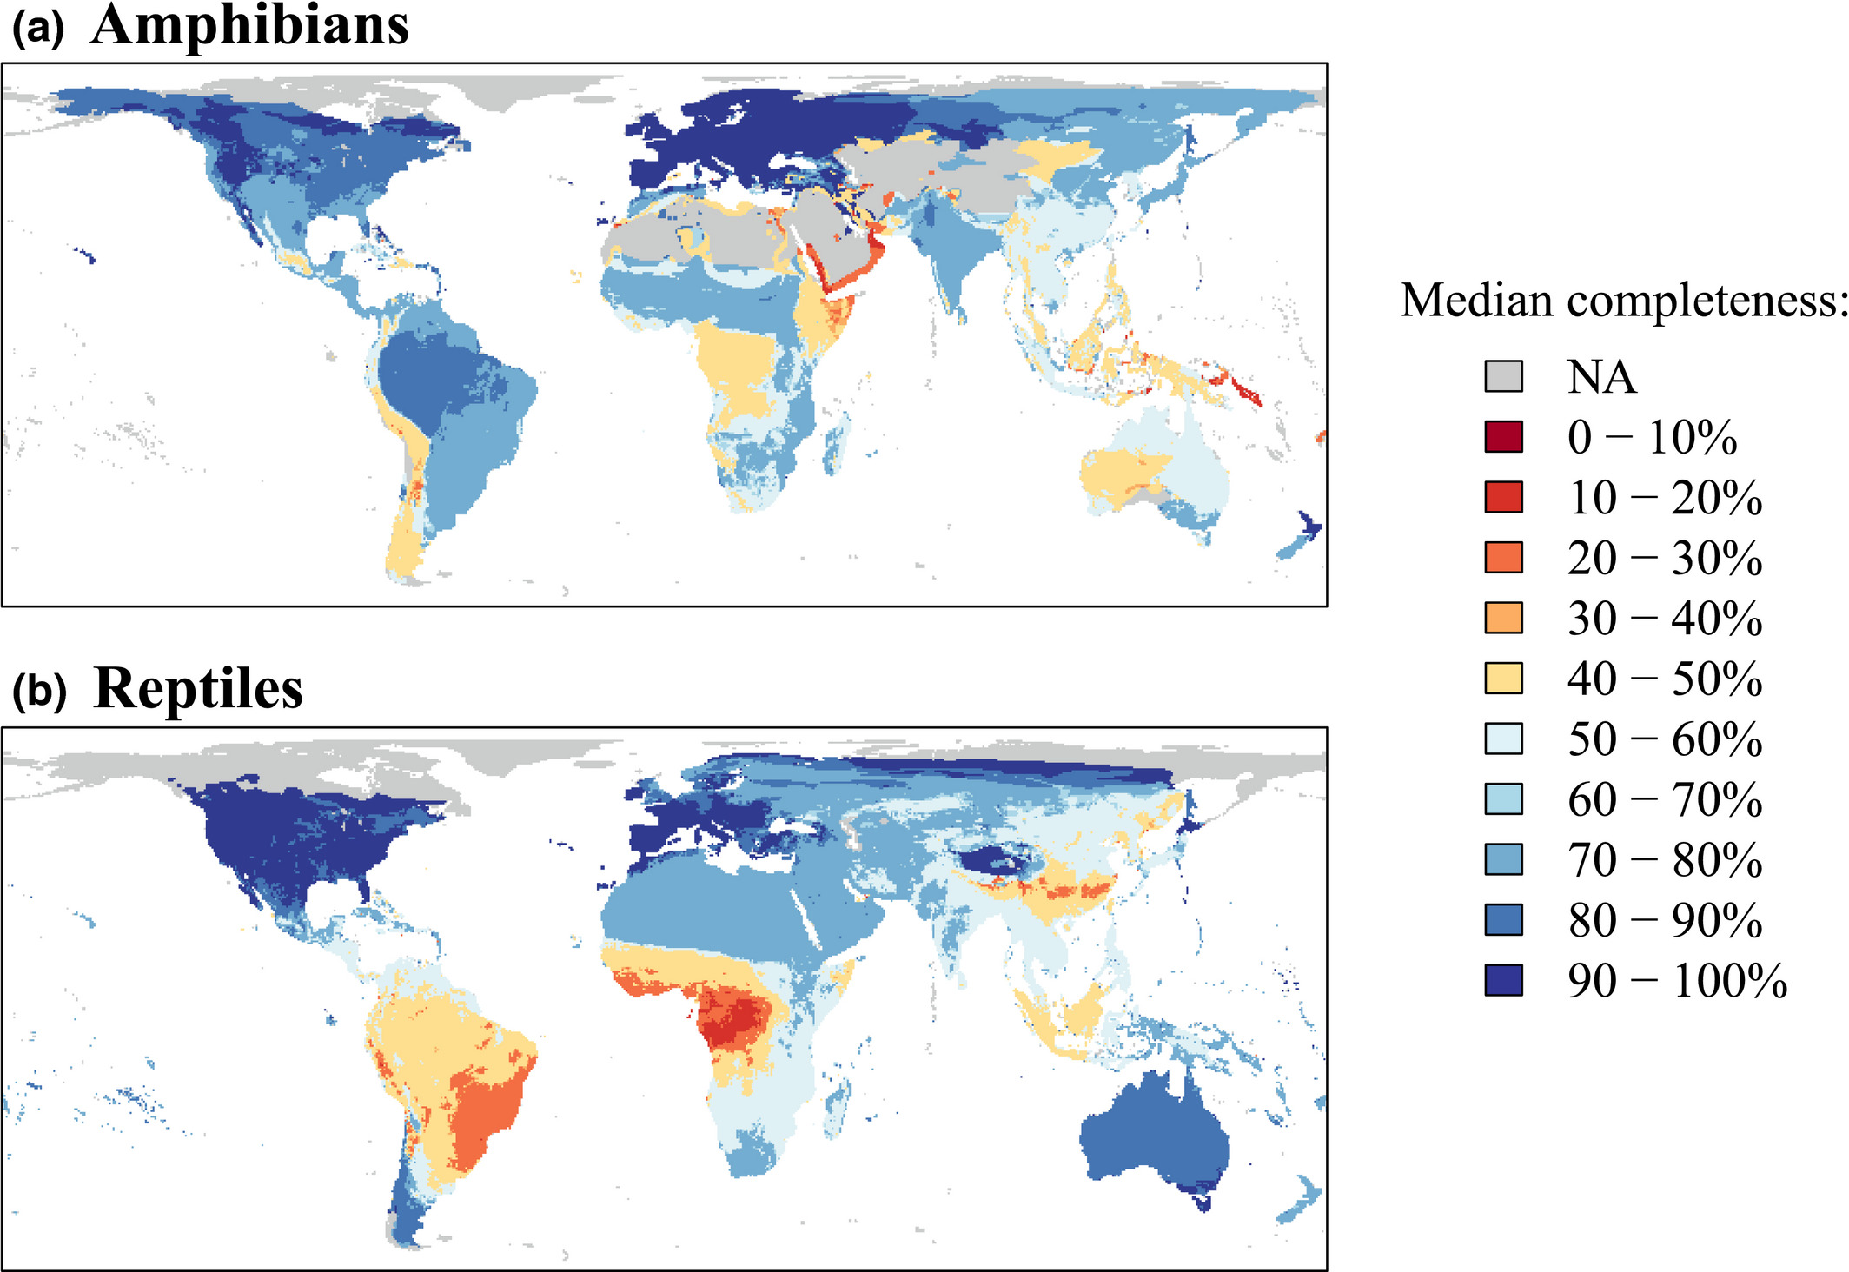
Chapter 2 – Global gaps in trait data for terrestrial vertebrates
Collect trait information across terrestrial vertebrates
Assess gaps and biases in the trait data
From: Etard et al. Global Ecology and Biogeography (2020)

Slide 25
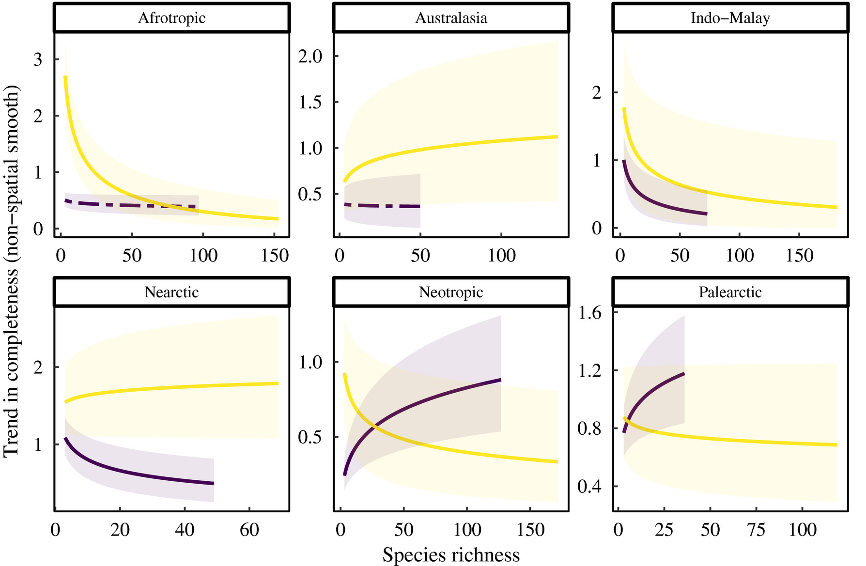
Chapter 2 – Global gaps in trait data for terrestrial vertebrates
Collect trait information across terrestrial vertebrates
Assess gaps and biases in the trait data
From: Etard et al. Global Ecology and Biogeography (2020)

Slide 26
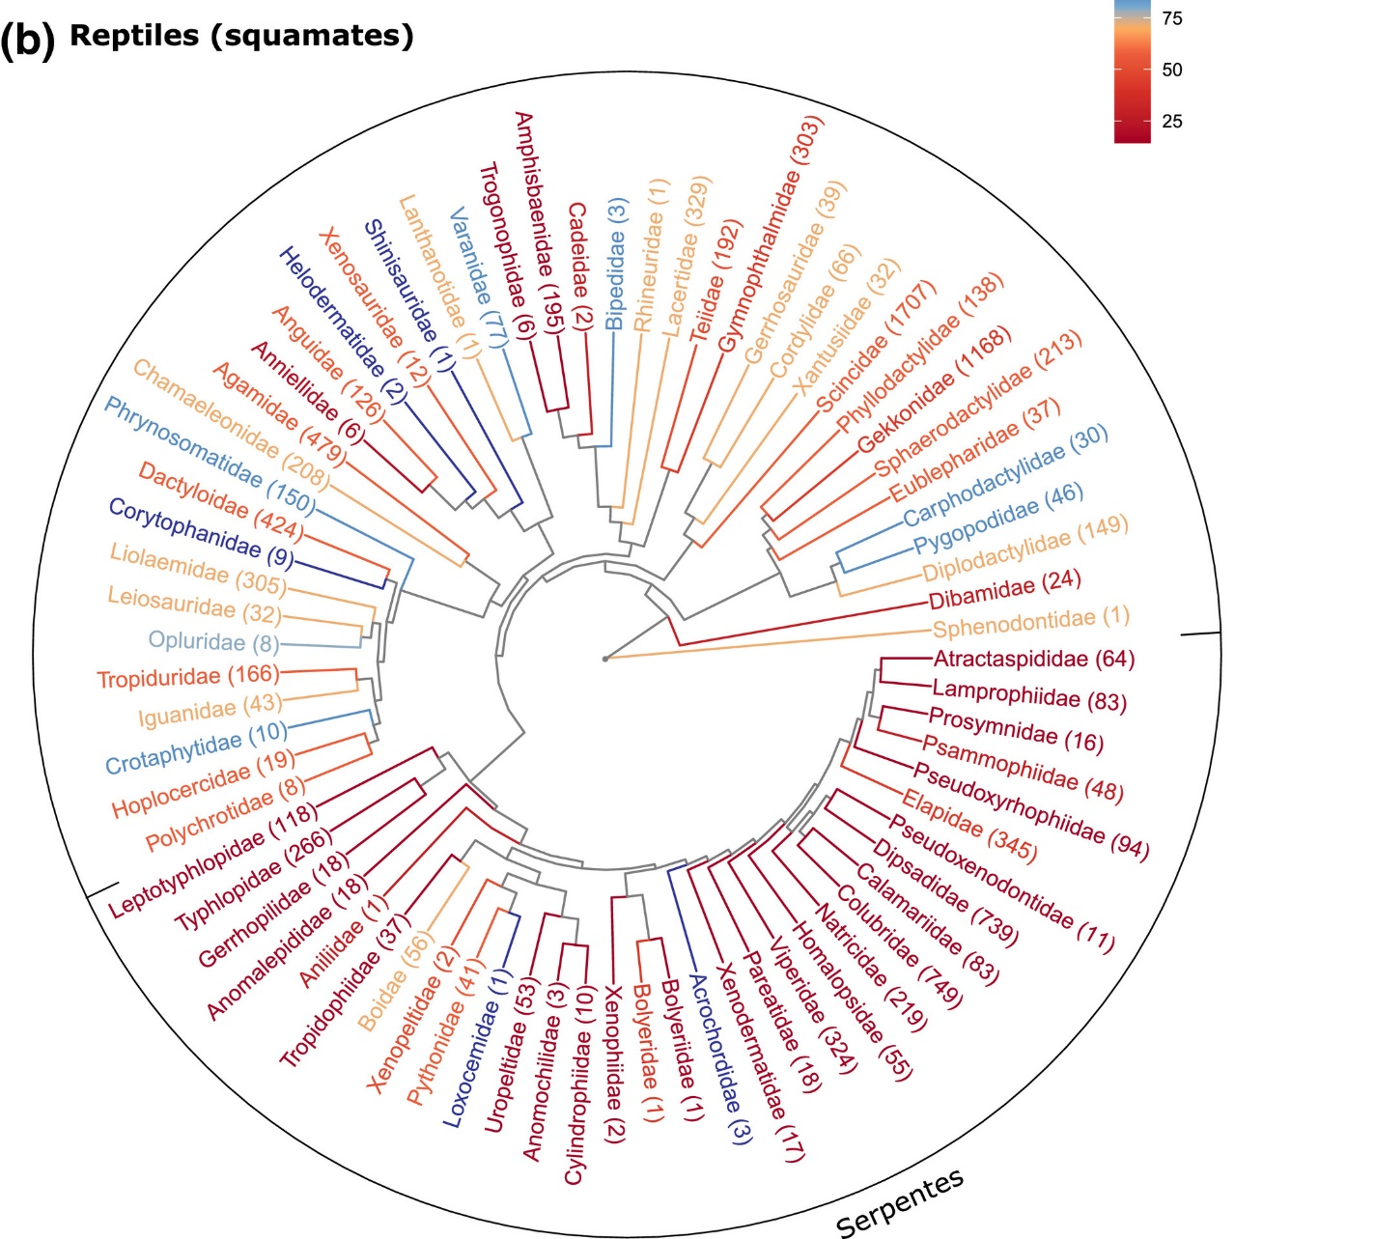
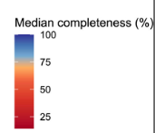
Chapter 2 – Global gaps in trait data for terrestrial vertebrates
Collect trait information across terrestrial vertebrates
Assess gaps and biases in the trait data
From: Etard et al. Global Ecology and Biogeography (2020)

Slide 27

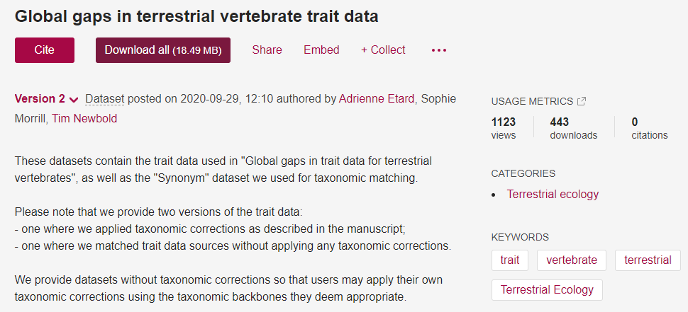
Chapter 2 – Global gaps in trait data for terrestrial vertebrates
Collect trait information across terrestrial vertebrates
Assess gaps and biases in the trait data

Slide 28
Land use & functional reshaping of
vertebrate assemblages (ecological traits)
Nov 2019 –
Paper submitted (Chapter 2)…
and 1st reject resubmit!
Conferences
Talks
PGTA duties
June 2018
Peer-reviews
F
I started working…
Collaborations
May 2022
Working from home
Nov 2021 –
Paper published
(Chapter 3)
Oct 2020 –
Paper
published
(Chapter 2)
March 2021 –
Paper submitted
(Chapter 3)

Slide 29
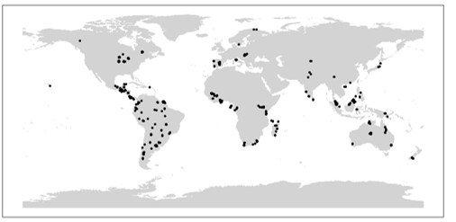
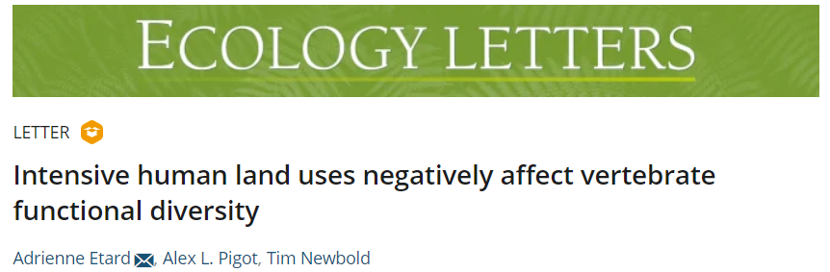
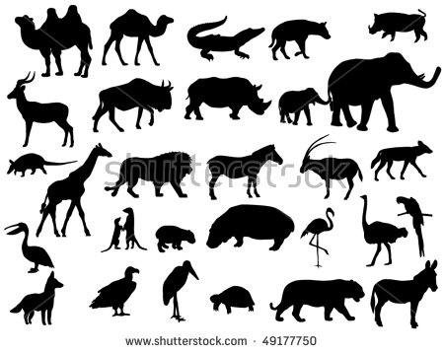



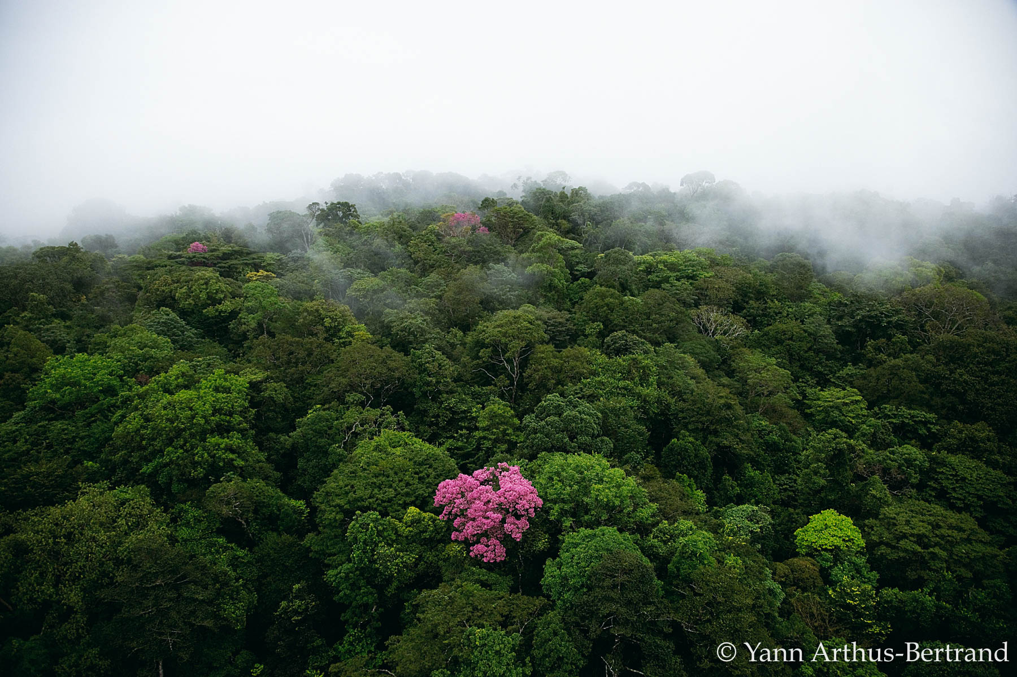
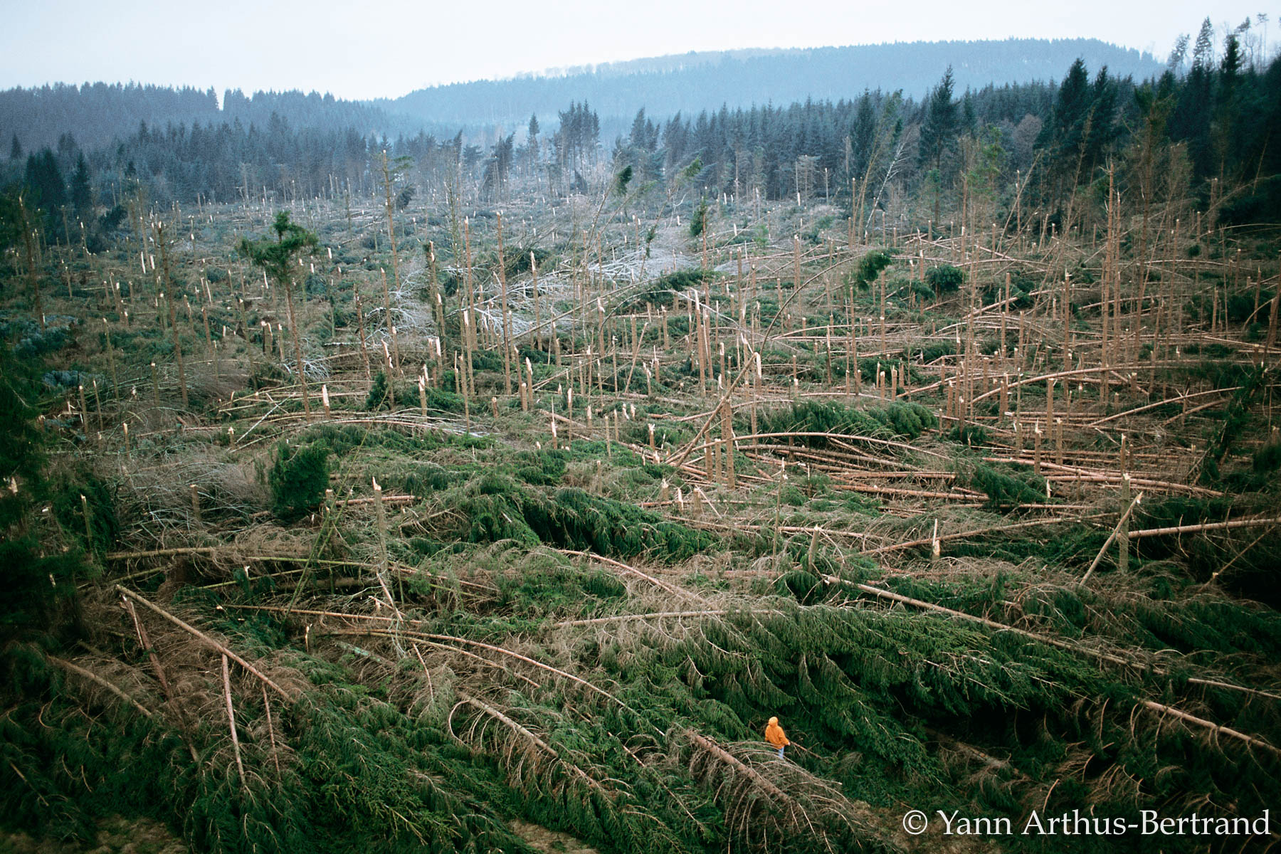
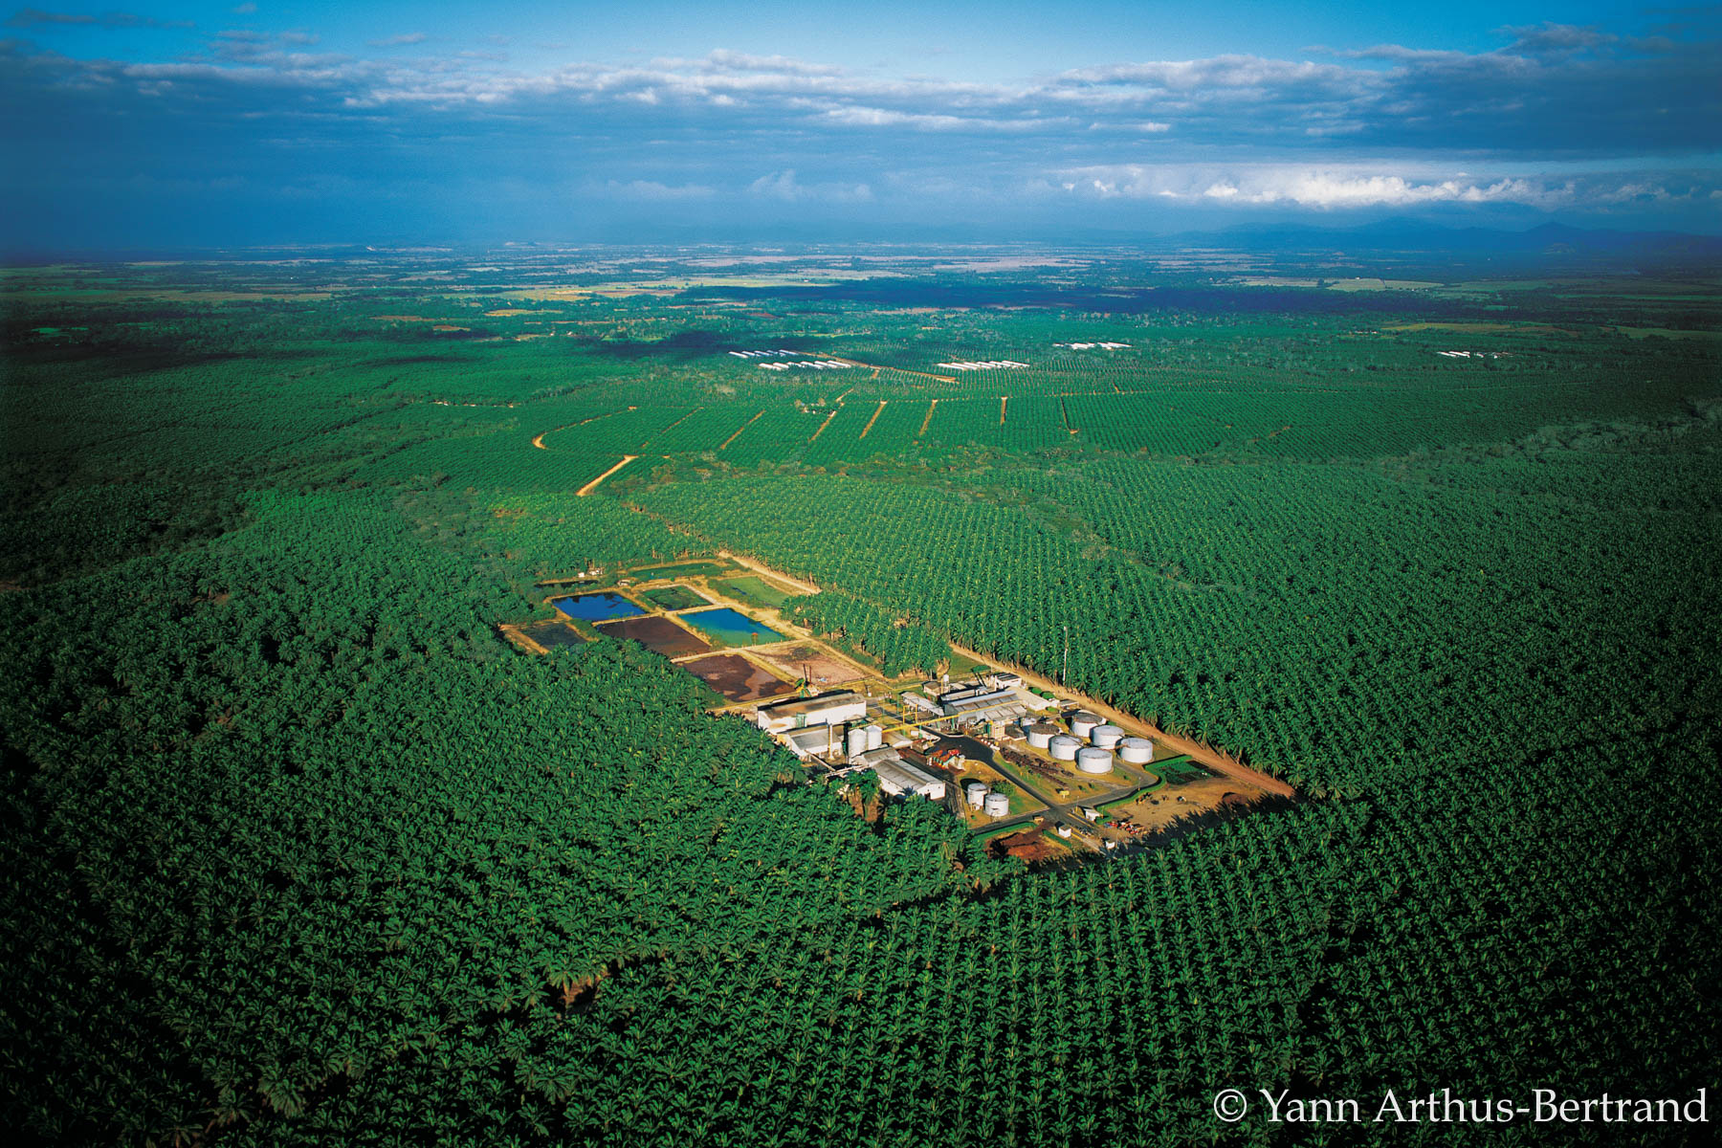
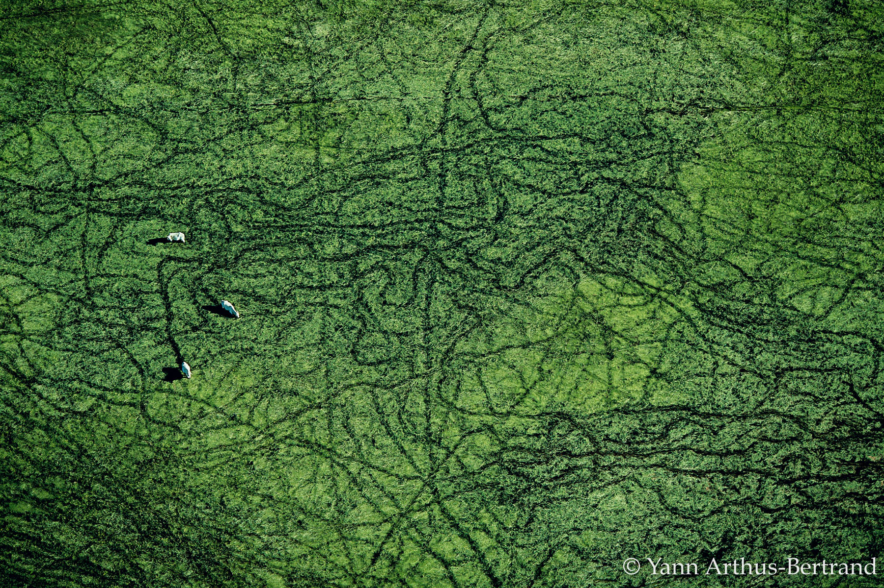
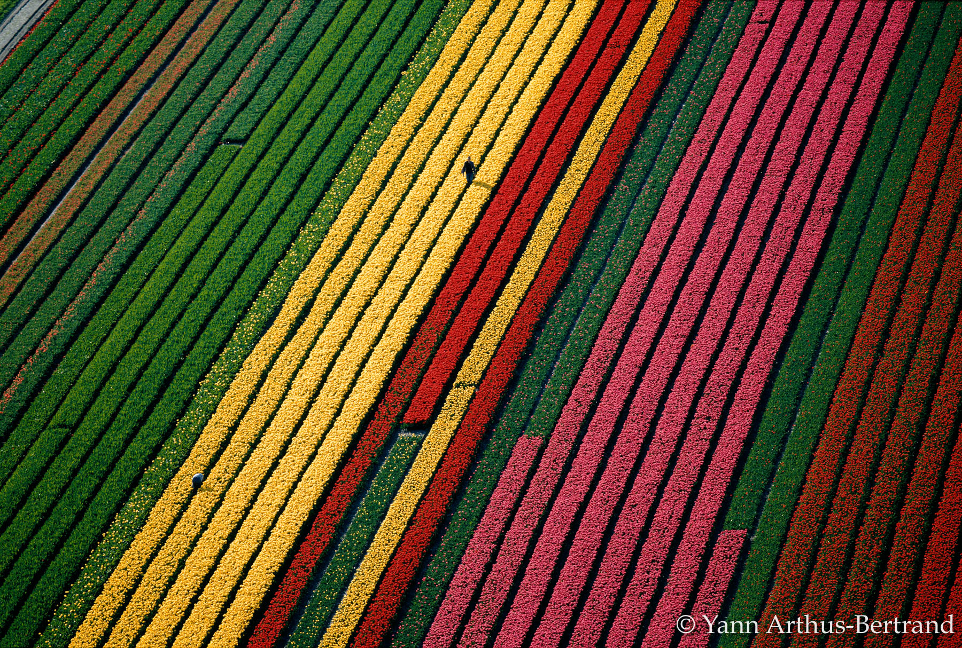
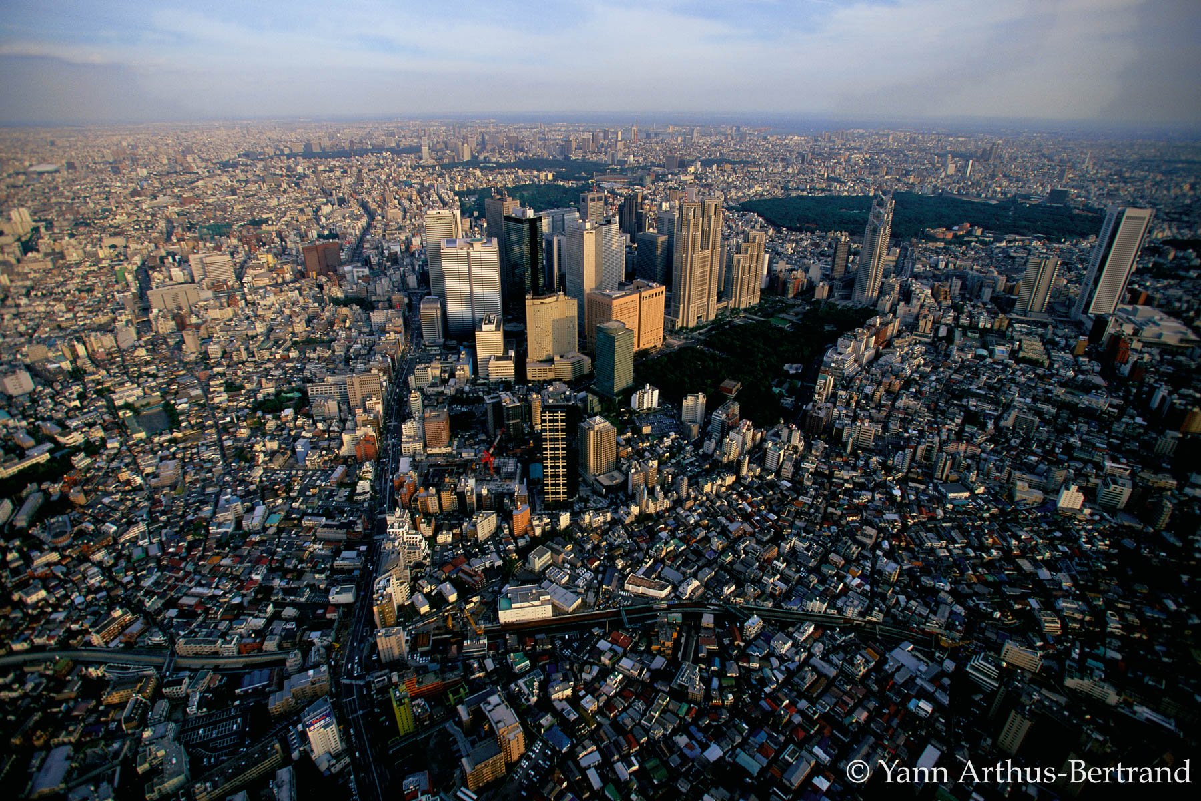
Chapter 3 – Intensive human land uses negatively affect vertebrate functional diversity
What effects of land use on vertebrate functional diversity? Are effects similar in temperate and tropical areas?
Are effects expected from changes in species richness?
Sample sizes
3,103
531
379
326
Primary
vegetation
Secondary
vegetation
Plantation
forest
Agricultural (Pasture + cropland)
Urban

Slide 30
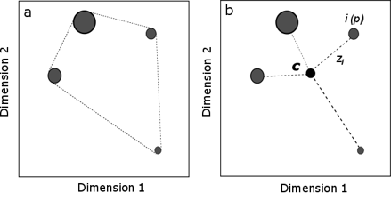
Chapter 3 – Intensive human land uses negatively affect vertebrate functional diversity
What effects of land use on vertebrate functional diversity? Are effects similar in temperate and tropical areas?
Are effects expected from changes in species richness?
Occurrence data in different land uses
+
(Imputed) traits
Local (site-level) functional diversity (richness, dispersion)
Functional richness
Functional dispersion
Across sites: Functional diversity ~ Land use

Slide 31
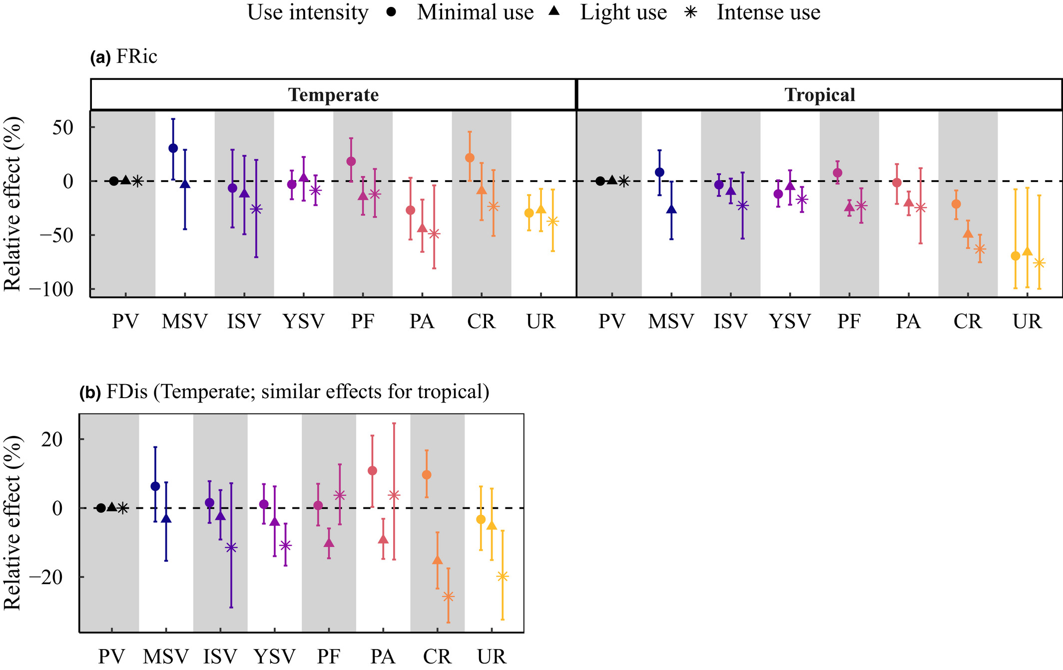
Chapter 3 – Intensive human land uses negatively affect vertebrate functional diversity
What effects of land use on vertebrate functional diversity? Are effects similar in temperate and tropical areas?
Are effects expected from changes in species richness?
Functional richness
Functional dispersion

Slide 32
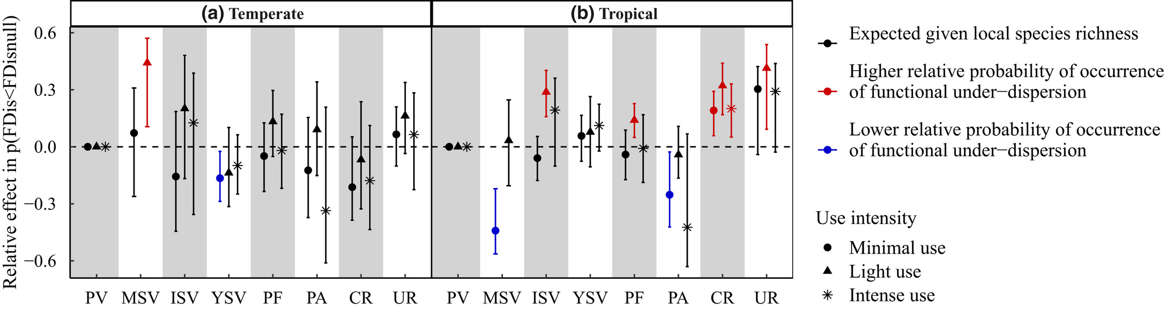
Chapter 3 – Intensive human land uses negatively affect vertebrate functional diversity
What effects of land use on vertebrate functional diversity? Are effects similar in temperate and tropical areas?
Are effects expected from changes in species richness?
Functional richness
Functional dispersion

Slide 33
Land use & functional reshaping of
vertebrate assemblages (physiological traits)
Nov 2019 –
Paper submitted (Chapter 2)…
and 1st reject resubmit!
Conferences
Talks
PGTA duties
June 2018
Peer-reviews
F
I started working…
Collaborations
May 2022
Working from home
Nov 2021 –
Paper published
(Chapter 3)
Oct 2020 –
Paper
published
(Chapter 2)
March 2021 –
Paper submitted
(Chapter 3)
May 2021 –
Letter of intention
(Chapter 5)
Jan 2021 –
Paper rejected
(Chapter 5)
Paper submitted
(Chapter 5)

Slide 34
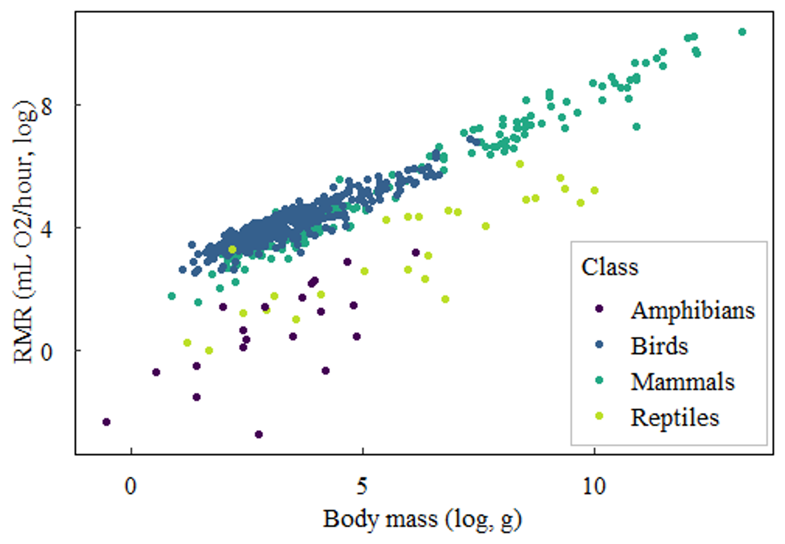
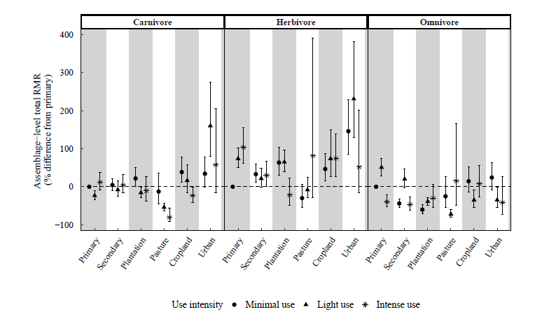
Chapter 5: Energetic constraints and trophic group explain species persistence in disturbed land uses
(1) Does land use influence energetic requirements at the assemblage level?
(2) Do species energetic requirements influence how they respond to land use?
Resting metabolic rates:
proxy for energetic expenditure
Hypothesis 1: within all trophic groups, total assemblage-level mass-dependent metabolic rates decrease in disturbed land uses compared to undisturbed land uses.

Slide 35
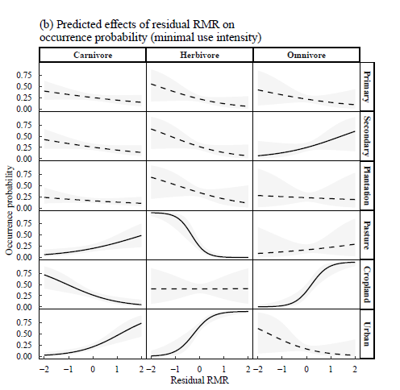
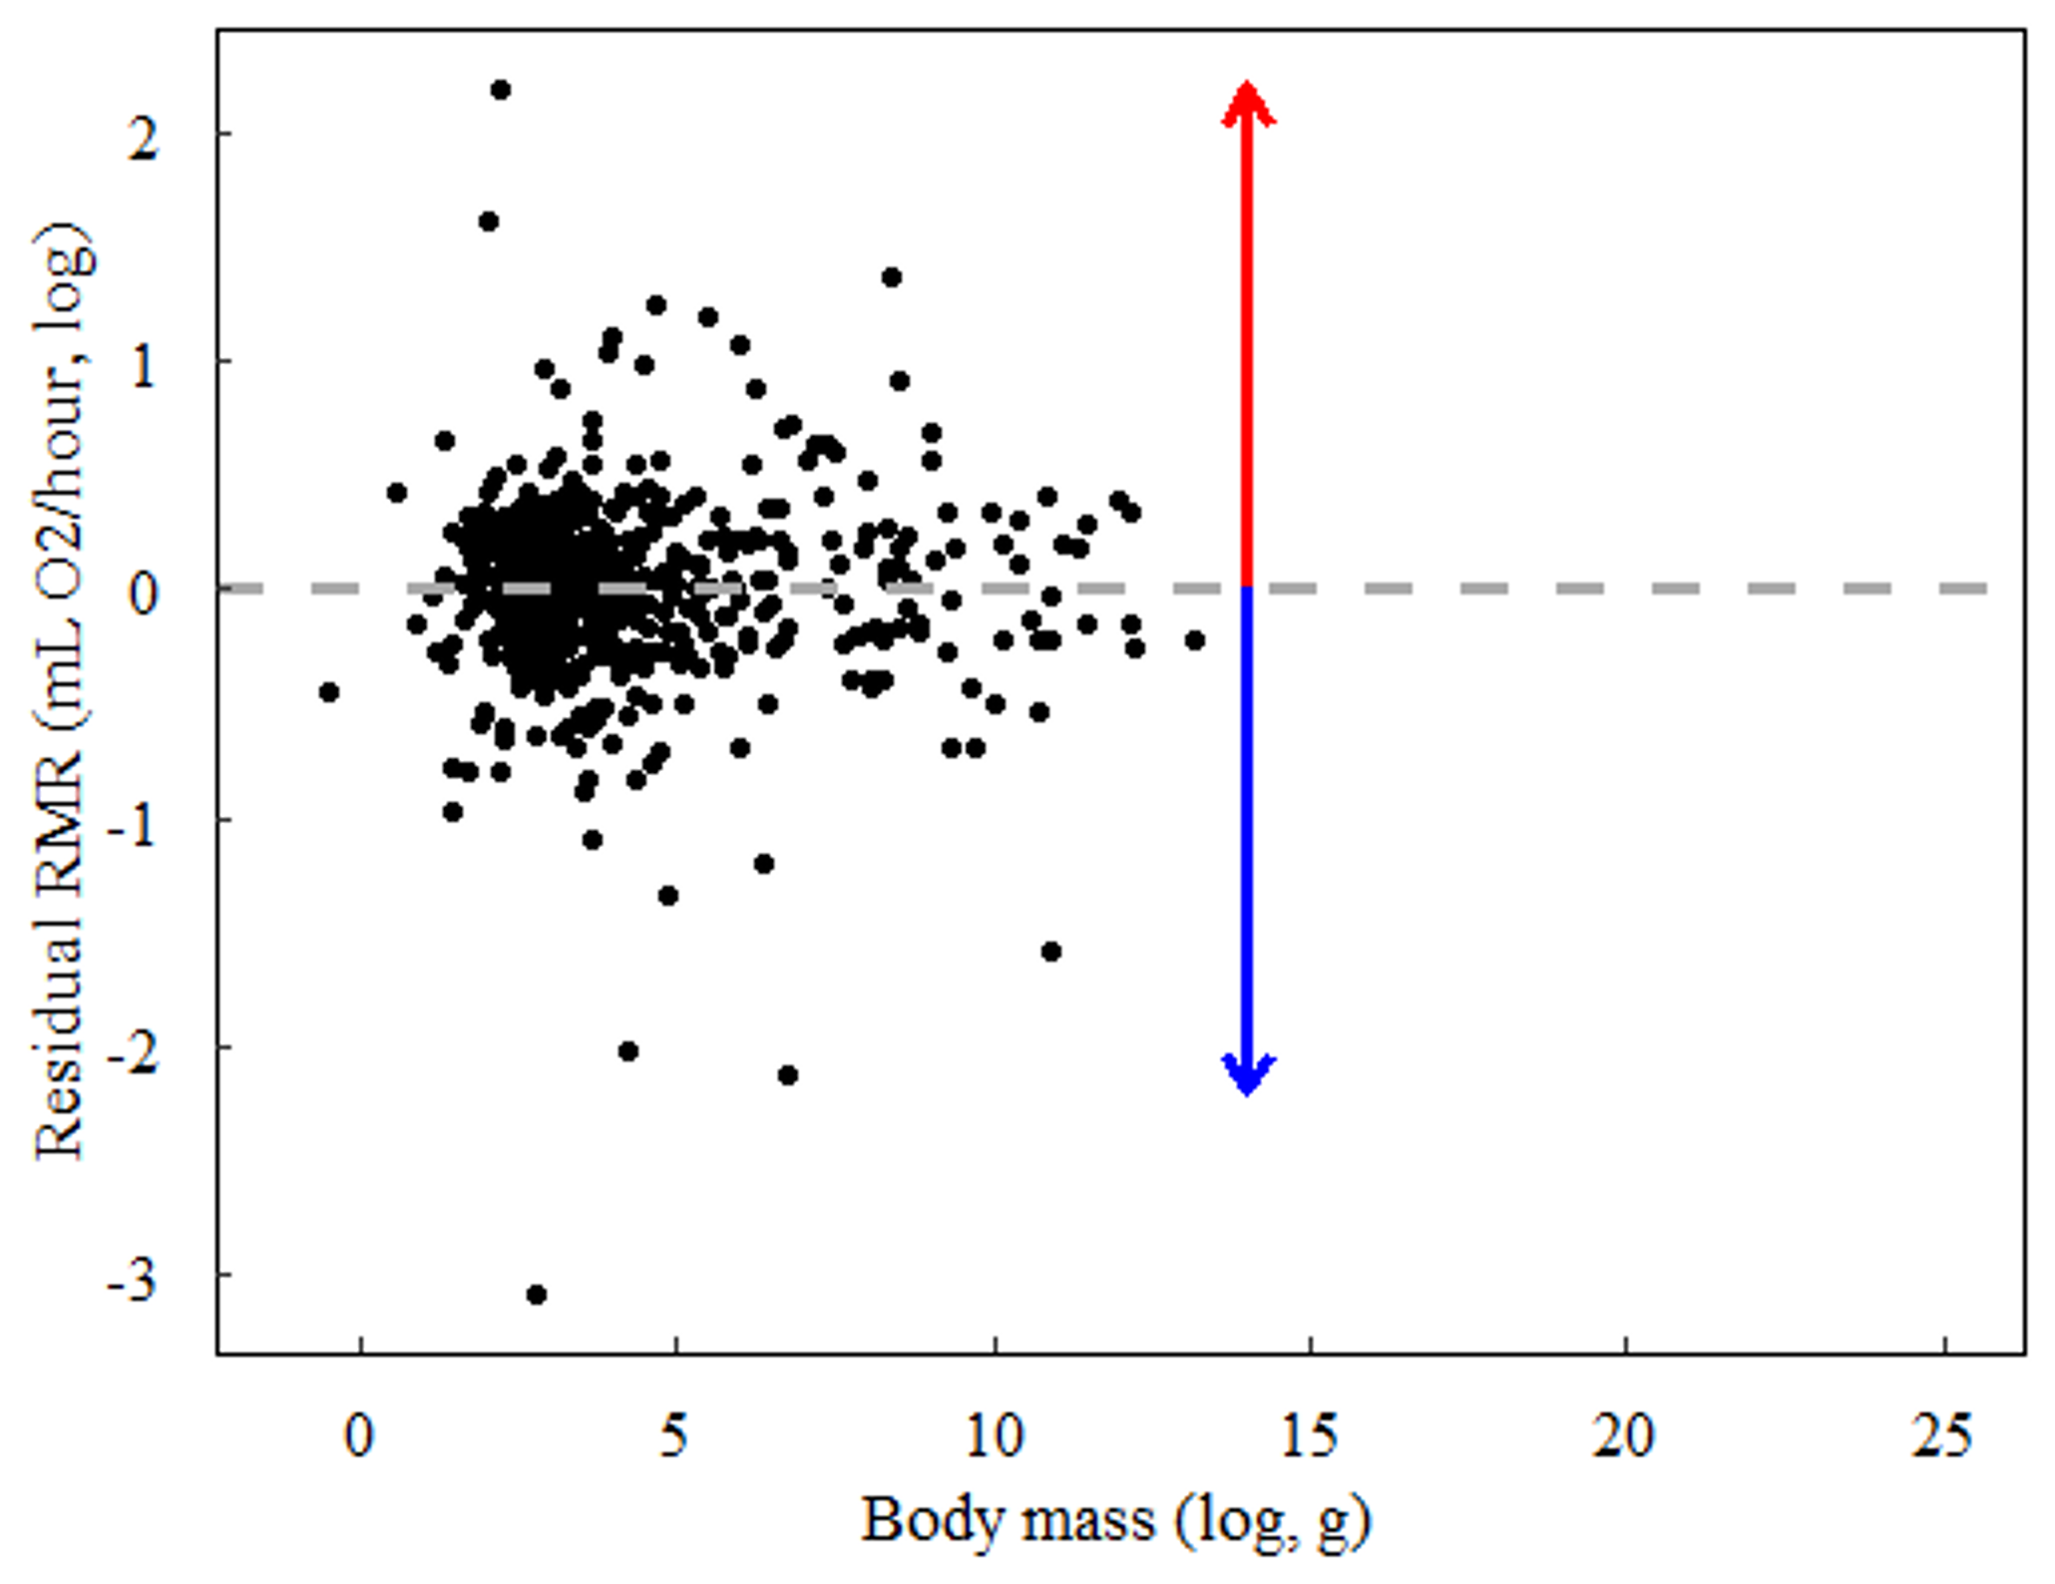
Chapter 5: Energetic constraints and trophic group explain species persistence in disturbed land uses
(1) Does land use influence energetic requirements at the assemblage level?
(2) Do species energetic requirements influence how they respond to land use?
Hypothesis 2: species’ occurrence probability in disturbed land uses is negatively affected by residual RMR.
Positive deviations:
RMR higher than
expected from
body mass
and taxonomy
Negative deviations:
RMR lower than
expected from
body mass
and taxonomy

Slide 36
Are traits associated with species’ land-use responses and climate-change sensitivity?
Nov 2019 –
Paper submitted (Chapter 2)…
and 1st reject resubmit!
Conferences
Talks
PGTA duties
June 2018
Peer-reviews
F
I started working…
Collaborations
May 2022
Working from home
Nov 2021 –
Paper published
(Chapter 3)
Oct 2020 –
Paper
published
(Chapter 2)
March 2021 –
Paper submitted
(Chapter 3)
May 2021 –
Letter of intention
(Chapter 5)
Jan 2021 –
Paper rejected
(Chapter 5)
Chapter 4
write-up
Paper submitted
(Chapter 5)

Slide 37
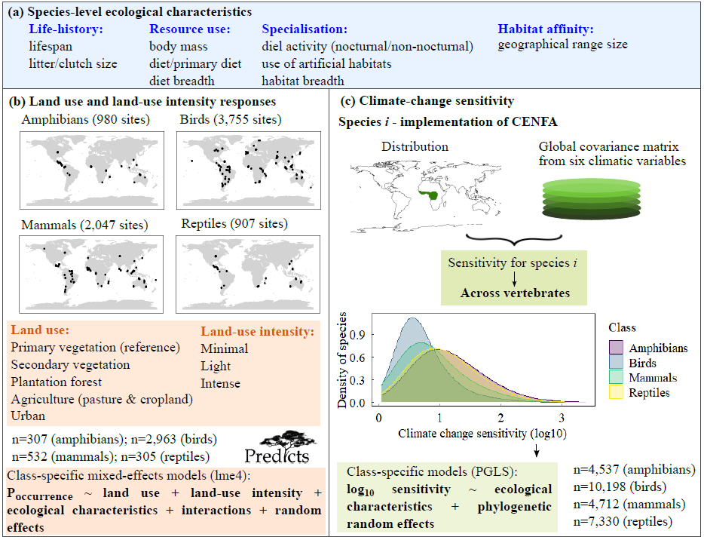
Chapter 4: Narrow-ranging natural habitat specialists are most sensitive to both land-use and climate change in terrestrial vertebrates
(2) Are there any emerging patterns in the associations between traits and sensitivity?

Slide 38
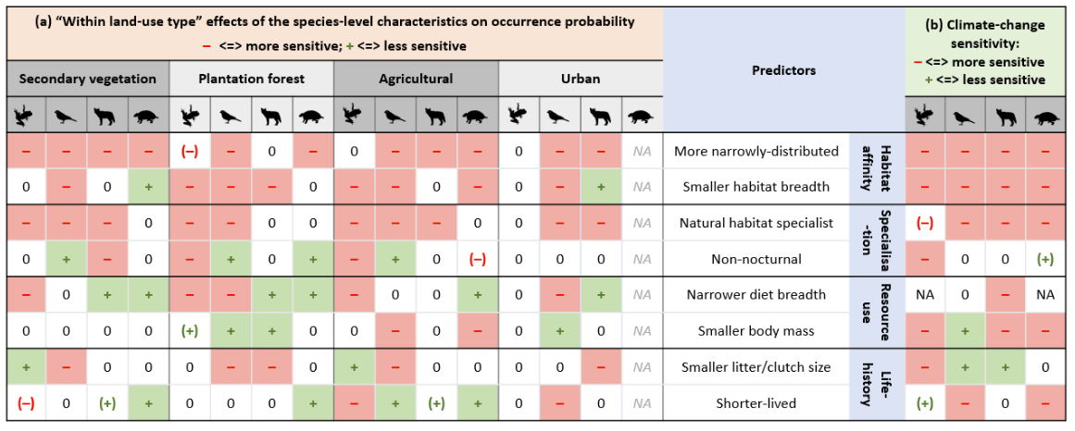
Chapter 4: Narrow-ranging natural habitat specialists most sensitive to both land-use and climate change in terrestrial vertebrates
(2) Are there any emerging patterns in the associations between traits and sensitivity?

Slide 39
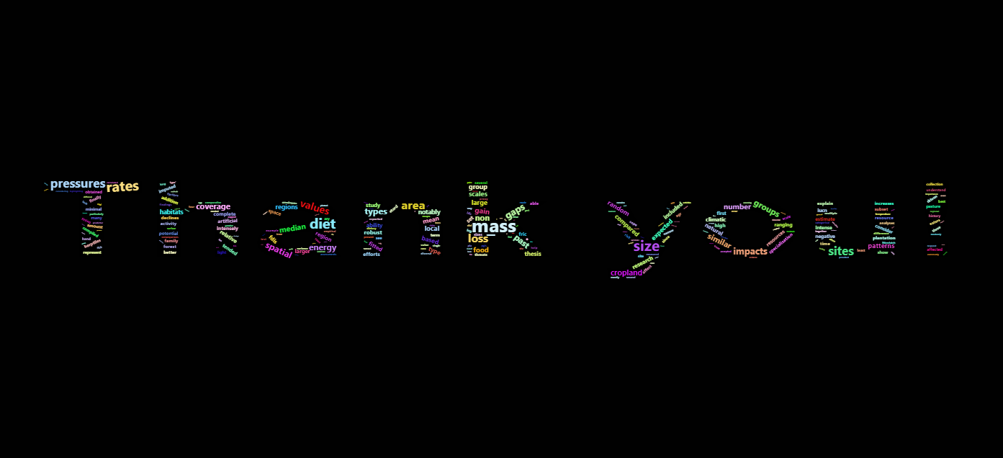


And Merry Xmas!

